Slide 1

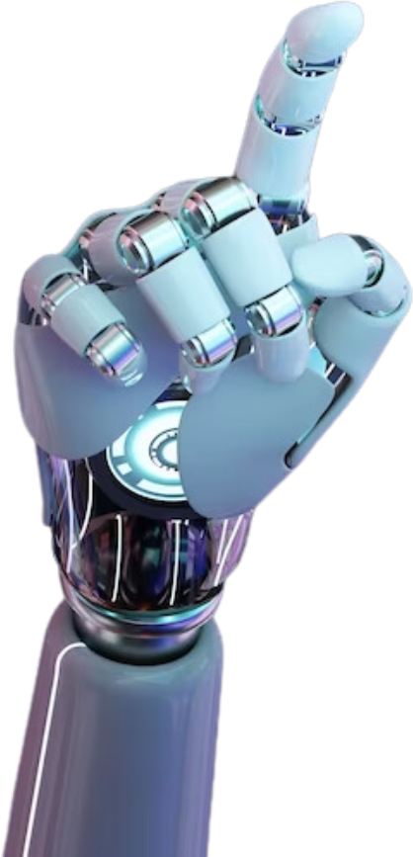
AI - Based Mental Health Chatbot
Presented by
Mohamed Nabeel 22BCE5250
Presented to
Saranya G.

Slide 2
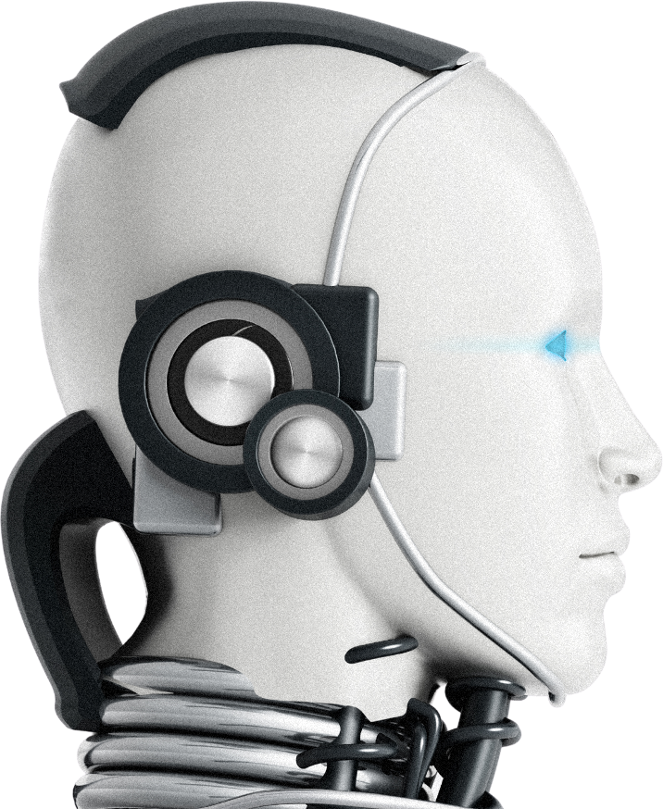

Novelty
The AI-based Mental Health Companion stands out in the mental health space by combining AI-driven conversational support with personalized mood tracking and resource recommendations. Unlike traditional mental health apps, this project aims to provide real-time, empathetic interactions that adapt to user inputs, allowing for a more engaging and supportive experience. The integration of continuous feedback loops and data analysis on depression and suicide rates further enhances the system's ability to evolve and provide tailored mental health support. This approach introduces a new level of personalization and adaptability in digital mental health tools.

Slide 3

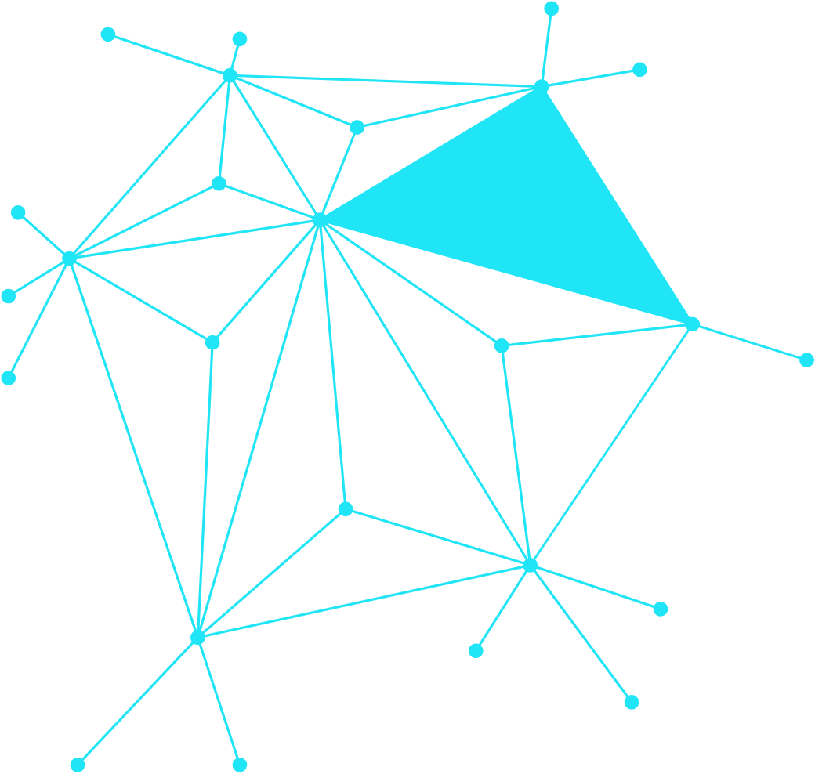
AI-Driven Conversations: Uses advanced natural language processing (NLP) to simulate empathetic and context-aware dialogues, offering users a more human-like interaction experience.
Personalized Mood Tracking: Incorporates a mood configurator that adjusts to the user's emotional state, providing tailored advice and support.
Dynamic Feedback Loop: Continuously evolves based on user feedback, ensuring that the companion remains relevant and responsive to individual needs.
Data-Driven Insights: Provides analytical reports on trends in depression and suicide rates, helping users and professionals make informed decisions.
Holistic Support: Combines conversational AI with resource recommendations, creating a comprehensive mental health support system.

Slide 4

Scope of the Project
Development of a Chatbot:
Creation of an interactive AI-based chatbot capable of engaging users in meaningful conversations about their mental health.
Mood Configuration:
Implementation of a mood tracking system that customizes interactions and advice based on the user’s current emotional state.
Resource Recommendations:
Integration of a feature that suggests relevant resources, such as articles, videos, or professional help, based on user input.
Feedback Mechanism:
Data Collection & Analysis:
Development of a continuous feedback system to refine the chatbot’s performance and improve user satisfaction.
Gathering and analyzing data on user interactions to generate reports on depression and suicide trends, contributing to a broader understanding of mental health issues.

Slide 5
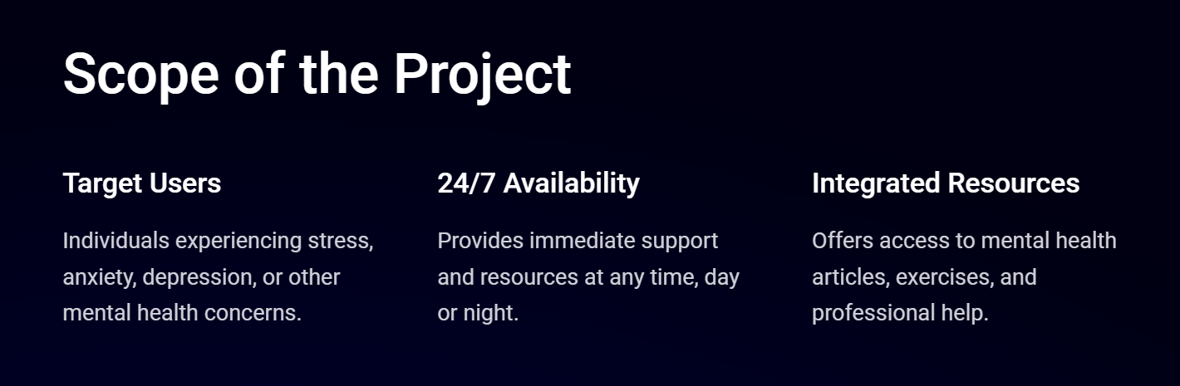


Slide 6

Problem Statement
Mental health issues, including depression and anxiety, are on the rise globally, yet access to timely and personalized mental health support remains limited. Many individuals may feel uncomfortable seeking help from traditional sources or may not have access to mental health professionals. The problem is exacerbated by the lack of immediate, tailored support that adapts to individual needs. This project addresses the gap by creating an AI-based Mental Health Companion that provides immediate, personalized mental health support, offering users a safe space to express their feelings, receive guidance, and access resources that are relevant to their specific situation.

Slide 7

Global Rise in Mental Health Issues:
Barriers to Traditional Support:
Stigma, cost, and limited availability of mental health professionals prevent many from seeking help.
Depression, anxiety, and other mental health conditions are increasing, yet many individuals lack access to timely and personalized support.
Need for Immediate and Tailored Assistance:
Existing digital tools often lack the ability to provide real-time, personalized support that adapts to individual needs.
Project Solution:
Develop an AI-based Mental Health Companion that offers immediate, personalized mental health support through AI-driven conversations, mood tracking, and resource recommendations, bridging the gap between users and accessible mental health care.

Slide 8
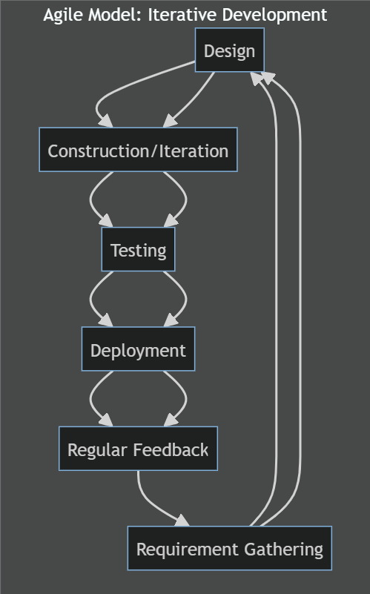
Design and Methodology Identified
Agile Model: Iterative development with regular feedback.
Requirement Gathering
Design
Construction/Iteration
Testing
Deployment

Slide 9
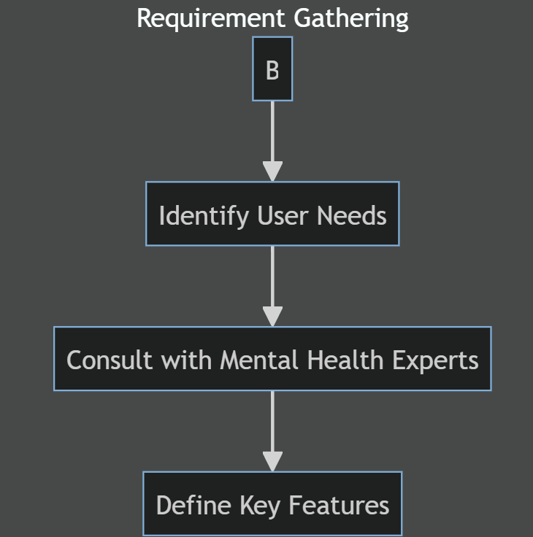
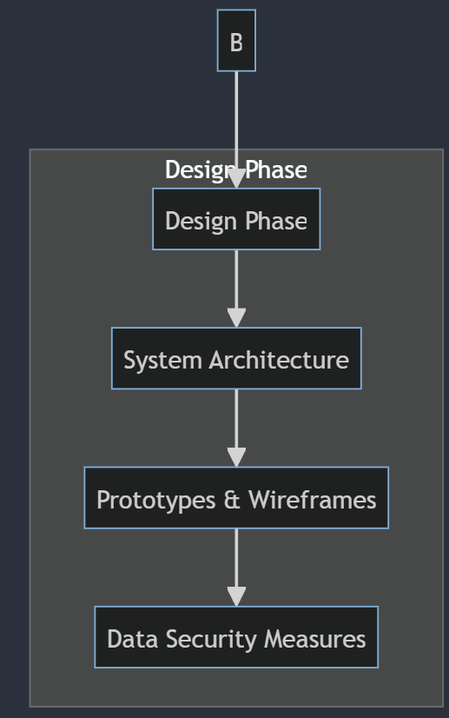
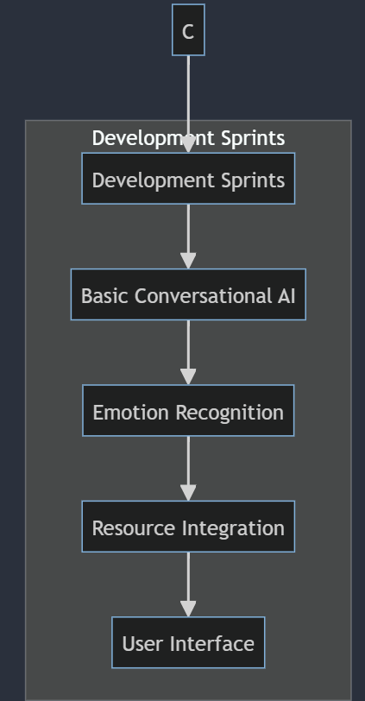
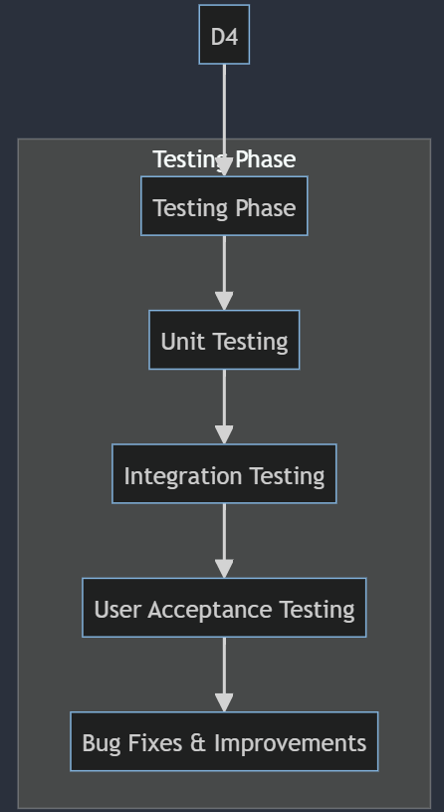
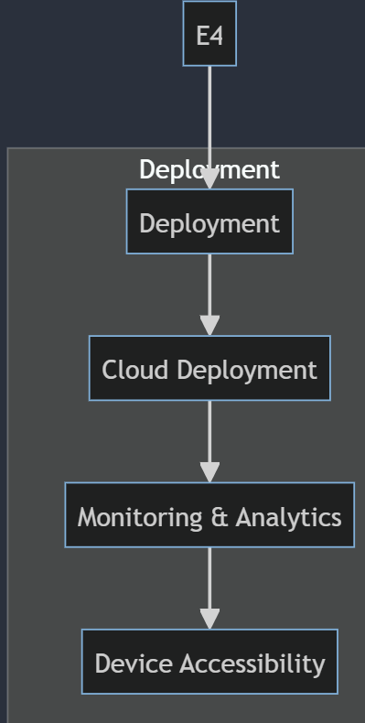
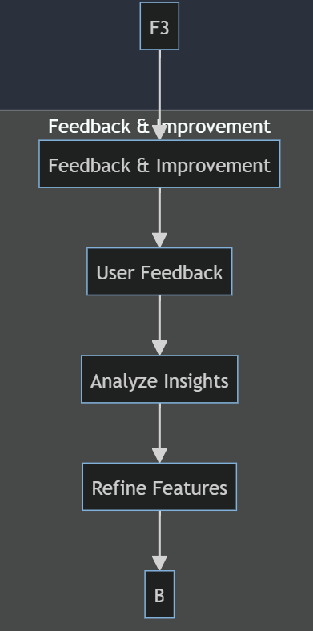
Process Flowchart Modules

Slide 10
Potential Journals and Conferences
Journal: Journal of Medical
Internet Research (JMIR)
Conference: International Conference
on Machine Learning (ICML)

Slide 11
Thank You!

